Slide 1
Child Development: Chapter 7 Cognitive Development

Slide 2
Chapter Outline
What Is Cognitive Development?
Theories of Cognitive Development
Piaget’s Theory of Cognitive Development
Theory of Core Knowledge
Vygotsky’s Sociocultural Theory of Cognitive Development
Information Processing
Comparing Theories of Cognitive Development

Slide 3
What is Cognitive Development?
Cognition is the study of how the mind works.
Cognitive development focuses on the changes that occur in how we think and learn as we grow.
Children do not just know less than adults do, there are differences in the very way that they think about and understand their experiences.

Slide 4
Theories of Cognitive Development: Piaget’s theory
Major contributions of Piaget’s theory:
Intelligence is an active, constructive, and dynamic process.
Mistakes children make in their thinking indicate the nature of their thought processes
As children develop, the structure of their thinking changes, and these new modes of thought are based on the earlier structures
(Flavell et al., 2002).

Slide 5
Piaget: Process of Development
Schemas
Disequilibrium/equilibration
Assimilation
Accommodation

Slide 6
Piaget’s Stages of Cognitive Development
Sensorimotor stage (birth-2 years)
Preoperational stage (2-7 years)
Concrete operational stage (7-12 years)
Formal operational stage (12 years and older)

Slide 7
Sensorimotor Stage
From reflexes to goal-directed activity
From the body to the outside world
Development of object permanence
From action to mental representation
Notes:
Video concerning object permanence at http://www.youtube.com/watch?v=NjBh9ld_yIo Or http://www.youtube.com/watch?v=ue8y-JVhjS0
Video about Baillargeon’s experiment: at http://home.cc.umanitoba.ca/~mdlee/Teaching/impossible.html

Slide 8
Preoperational Stage
Development of symbols
Transductive reasoning and magical explanations
Egocentrism
Animism
Lack of conservation
Notes:
Films showing the conservation experiments at http://video.google.com/videosearch?sourceid=navclient&ie=UTF-8&rlz=1T4ADBR_enUS246US262&q=Piaget's%20conservation%20experiment&um=1&sa=N&tab=wv# http://www.youtube.com/watch?v=MpREJIrpgv8&feature=related

Slide 9
Stage of Concrete Operations
Logical thought
Reversibility
Classification
Not capable of thinking abstractly

Slide 10
Stage of formal operations
Abstract thought
Hypothetico-deductive reasoning: The ability to form hypotheses about how the world works and to reason logically about
Notes:
Video showing the difference between concrete and formal operational thinking at http://www.youtube.com/watch?v=lw36PpYPPZM&NR=1

Slide 11
Adolescent egocentrism
David Elkind’s ideas:
Imaginary audience
Personal fable

Slide 12
Critique of Piaget
Ages are not necessarily correct.
Stages are not necessarily distinct from one another.
Do his ideas stand up across cultures?

Slide 13
Theory of Core Knowledge
The theory that basic areas of knowledge are innate and built into the human brain.
Spelke and Kinzler (2007) present evidence for four areas of core knowledge:
1. Knowledge that an object moves as a cohesive unit, it does not contact another object unless they are close to each other, and it moves on a continuous path.
2. Knowledge that agents (people) act purposefully toward a goal.
3. Knowledge (within limits) of number
4. Knowledge of spatial relationships,

Slide 14
Lev Vygotsky (1896 - 1934)
Zone of proximal development and Scaffolding
Private speech

Slide 15
Information processing
How is information is selected, stored, and retrieved
the stores model
the connectionist or neural network model.

Slide 16
Processing information
Attention
Memory
Executive function
Metacognition

Slide 17
Attention
Infancy
Infant preference for novelty
Habituation
Childhood
Ability to direct and sustain attention
Individual differences
Processing efficiency: automaticity
Adolescence
Multitasking myth

Slide 18
ADHD
3-7% of children, more boys than girls
Two types:
Inattentive type
Hyperactive/impulsive type
Treatments:
Work with parents
Work with school and teachers
medication
Notes:
Video describing behavior of children with ADHD and ways to help control their behavior at http://www.nhs.uk/video/pages/medialibrary.aspx?Filter=&Id=%7Bd50278d5-00b7-4f16-b4ea-614dede9b4b1%7D&Tag=&Uri=video/2009/February/Pages/ADHDchildren.aspx (Production of the British National Health Services)

Slide 19
Memory
Infancy
Rovee-Collier’s paradigm showed that 6 month olds remember a stimulus for 1 week, 18 month olds remember for13 weeks.
Infantile amnesia – although infants can remember, older children and adults have difficulty remembering events from before age 3.
Notes:
There is a video of the experimental paradigm used by Rovee-Collier at http://www.youtube.com/watch?v=lPJiB-oGMN0

Slide 20
Remember these
Apple
Iron
Stapler
Monkey
River
Pencil
Mountain
Driver
Notes:
Show students the list of words for 30 seconds. Then have them write down what they remember. Most importantly, ask them how they went about trying to remember the words. This is a demonstration of encoding processes that adults use to store information.

Slide 21
Memory in childhood
Encoding strategies
Scripts
Repetition/rehearsal
Organization/association
Elaboration
Knowledge base
The more someone knows about a topic, the easier it is to remember new, related information.
False memories

Slide 22
Executive Function
Executive function coordinates attention and memory and controls behavioral responses for the purpose of attaining a certain goal.
Inhibition: the ability to stay on task and ignore distractions
Cognitive flexibility: the ability to switch focus as you need to in order to complete the task

Slide 23
Metacognition
Metacognition: the ability to think about and monitor one’s own thoughts and cognitive activities.
Metamemory: the understanding of memory, how it works, and how to use it effectively.

Slide 24
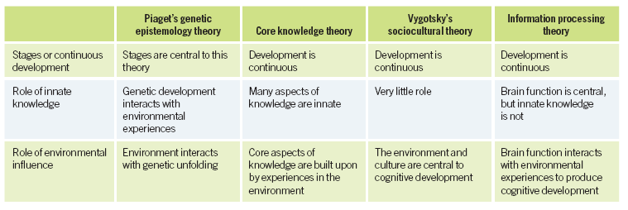
Comparing Cognitive Theories

